Slide 1
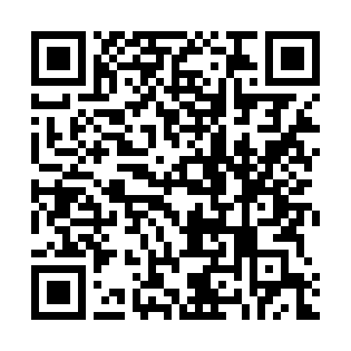
Getting Started with Achieve
A step-by-step guide to registering for your course
Scan here for online details:

Slide 2

What is Achieve?
Achieve is your complete online course — everything you need to succeed, in one place.
●
Your e-book Read, search, highlight, and take notes anytime.
●
Homework & quizzes Practice with instant feedback as you go.
[Achieve screenshot]
●
Multimedia tools Videos and activities that help concepts click.
●
A full gradebook Track your progress — and so can your instructor.
●
8% boost on your final exam grade! Students who complete at least 81% of their pre-class activities can expect this boost!

Slide 3
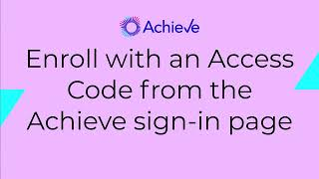

Slide 4
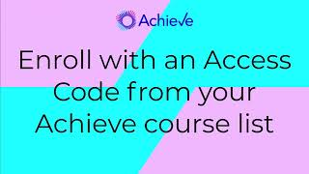

Slide 5
How It Works
Three simple stages. This guide walks you through each one.
1
2
3
Go to the site
→
Choose your path
→
Create your account
Head to Achieve and start enrolling in your course.
Use an access code or your course ID to get access.
Fill out the form and you're in — ready to learn.

Slide 6
STAGE 1
Go to the Site

Slide 7
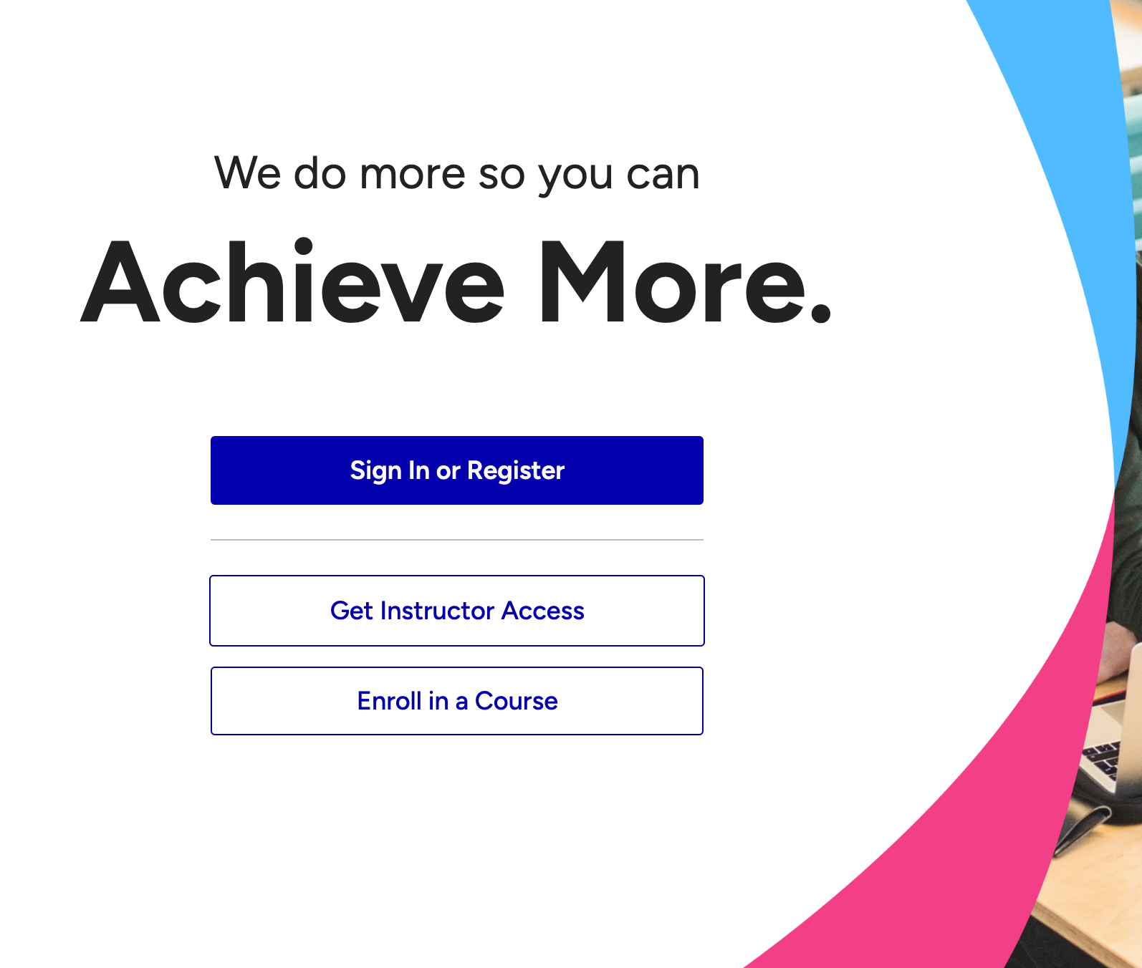
Start Here
Achieve.MacmillanLearning.com
1
Go to the address above.
2
Click "I Need to Enroll in a Course."
Instructor shared a course link? Start there instead, and go straight to the "Create an Account" step.

Slide 8
STAGE 2
Choose Your Path
You'll be asked for an access code OR a course ID. Follow the path that matches what you have.

Slide 9
Which Do You Have?
Enter your access code or course ID. Already purchased access before? Just sign in.
PATH A · ACCESS CODE
PATH B · COURSE ID
You have a printed or emailed access code.
You have a course ID but no code yet.
Enter your code → create your account.
You'll get three options to gain access (next slides).
The fastest path.
Buy · Free trial · Enter a code

Slide 10
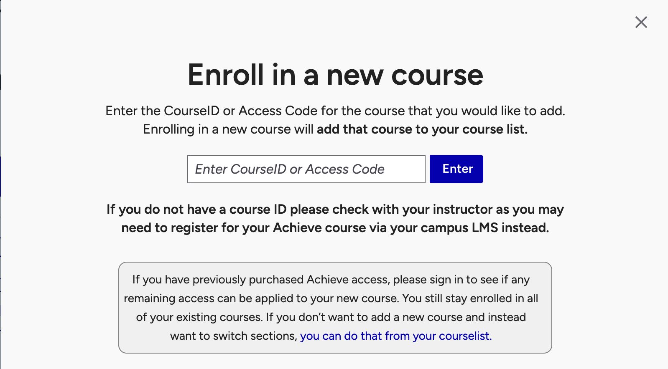
Path A: Access Code
PATH A · ACCESS CODE
1
Type in your access code.
2
Create an account — or sign in if you already have one.
3
That's it! Head to "Create Your Account" for the details.
Then skip ahead to the "Create Your Account" slide.

Slide 11
Path B: Course ID
PATH B · COURSE ID
Enter your course ID, then pick one of three ways to get access:
OPTION 1
OPTION 2
OPTION 3
Purchase Access Online
Start a Grace Period
Already Have a Code
Buy access through our Student Store. Pick your access period and check out.
Get 14 days of free access to begin. Add full access before it ends.*
Enter a code you've purchased or received, and create your account.
*Not available for all courses.

Slide 12
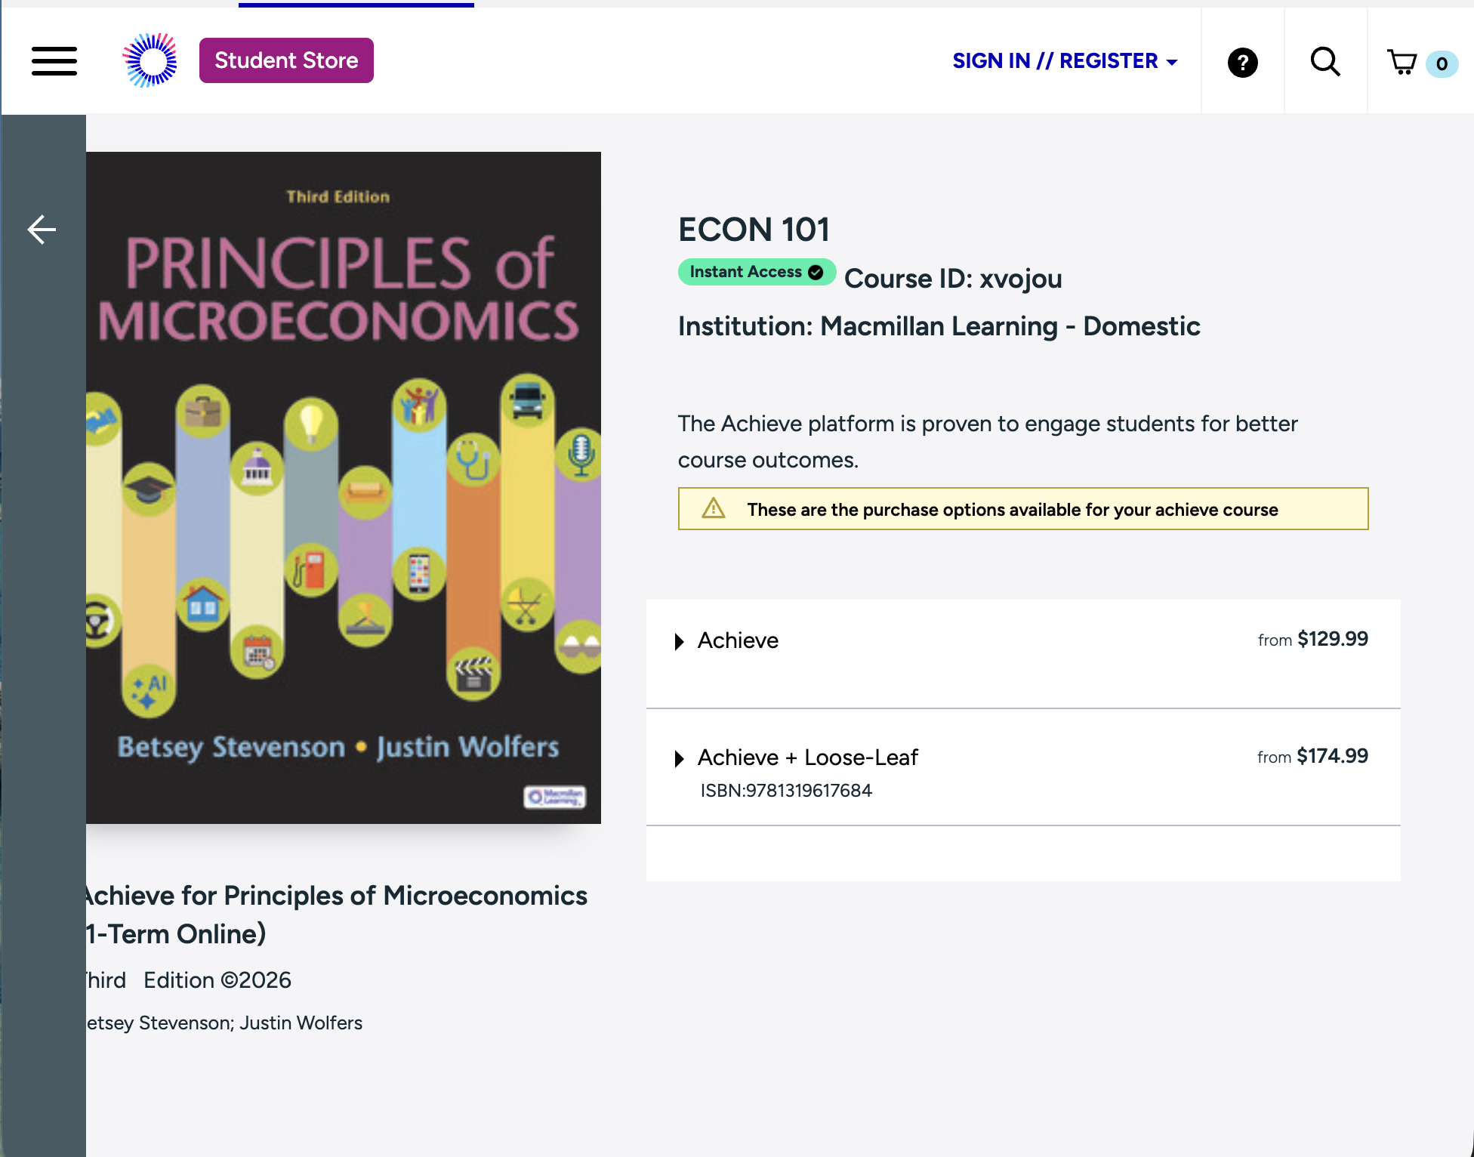
Option 1: Buy Online
OPTION 1 · BUY ONLINE (1 of 2)
1
Select "Purchase Achieve Access." You'll go to the Student Store.
2
Sign in, or click "Need an account? Create one now" and fill out the form.
3
Agree to the terms and create your account.
4
Back in the Store: expand Achieve, click "Subscribe," and Add to Cart.

Slide 13
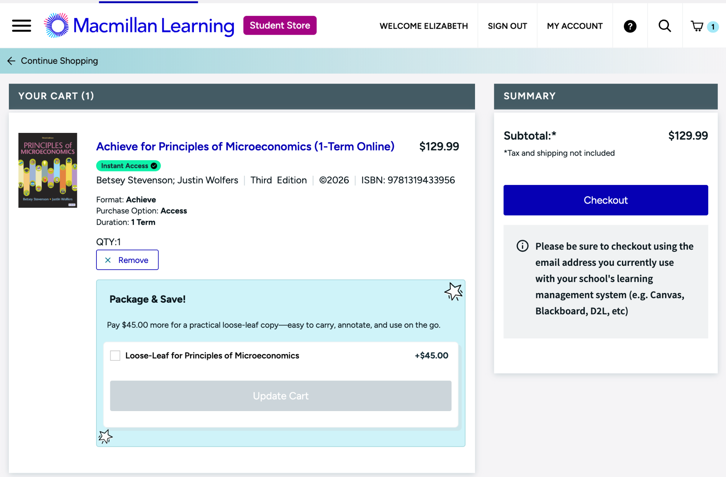
Option 1: Buy Online
OPTION 1 · BUY ONLINE (2 of 2)
5
View your cart and click "Checkout."
6
Fill in your payment info: address, delivery, review, purchase.
7
Watch for your confirmation email, then click "Go to Achieve."
You're enrolled! You can also track your order under "My Account."

Slide 14
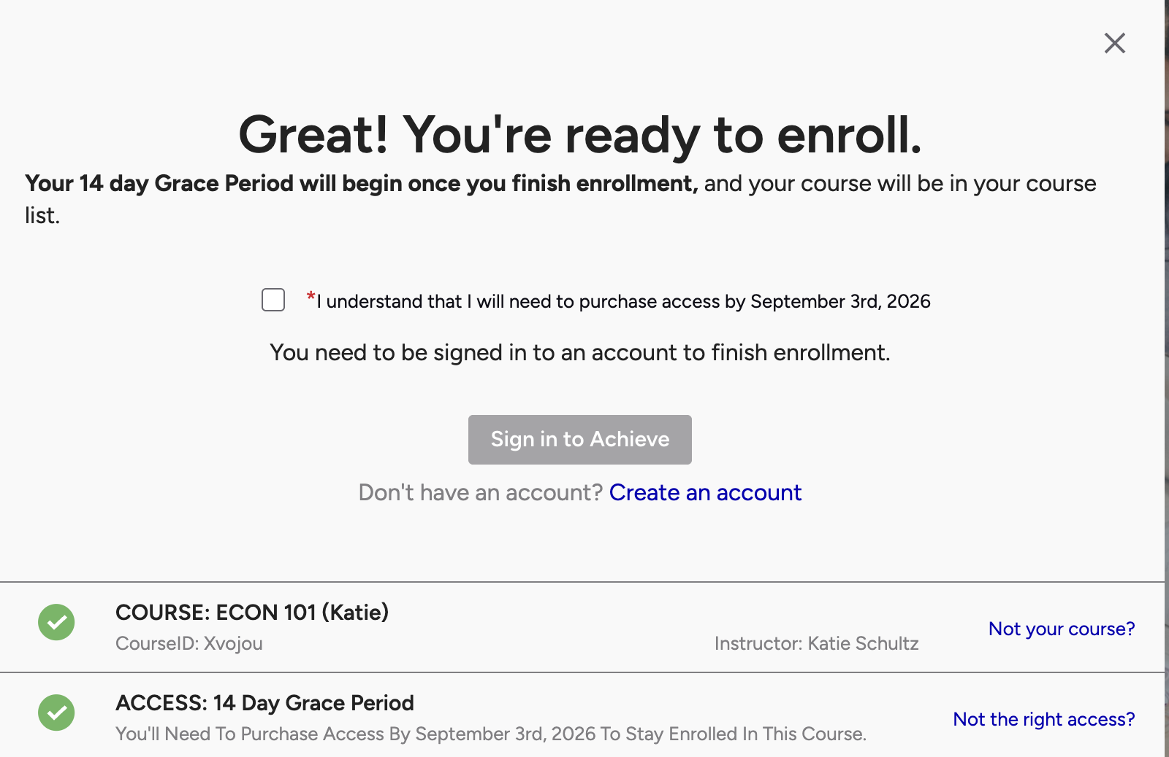
Option 2: Free Trial
OPTION 2 · FREE TRIAL
1
Select "Start a Grace Period" for 14 days of free access.
2
Check the box confirming you know when the trial ends.
3
Create an account (or sign in) — and you're in.
Before day 14: Add full access from your course dashboard (three-dot menu). Sign in to the same account you used for the trial!

Slide 15
Option 3: Have a Code
OPTION 3 · ENTER A CODE
1
Enter the access code you purchased or received.
2
Create an account — or sign in if you already have one.
3
You're in! See "Create Your Account" next for the details.

Slide 16
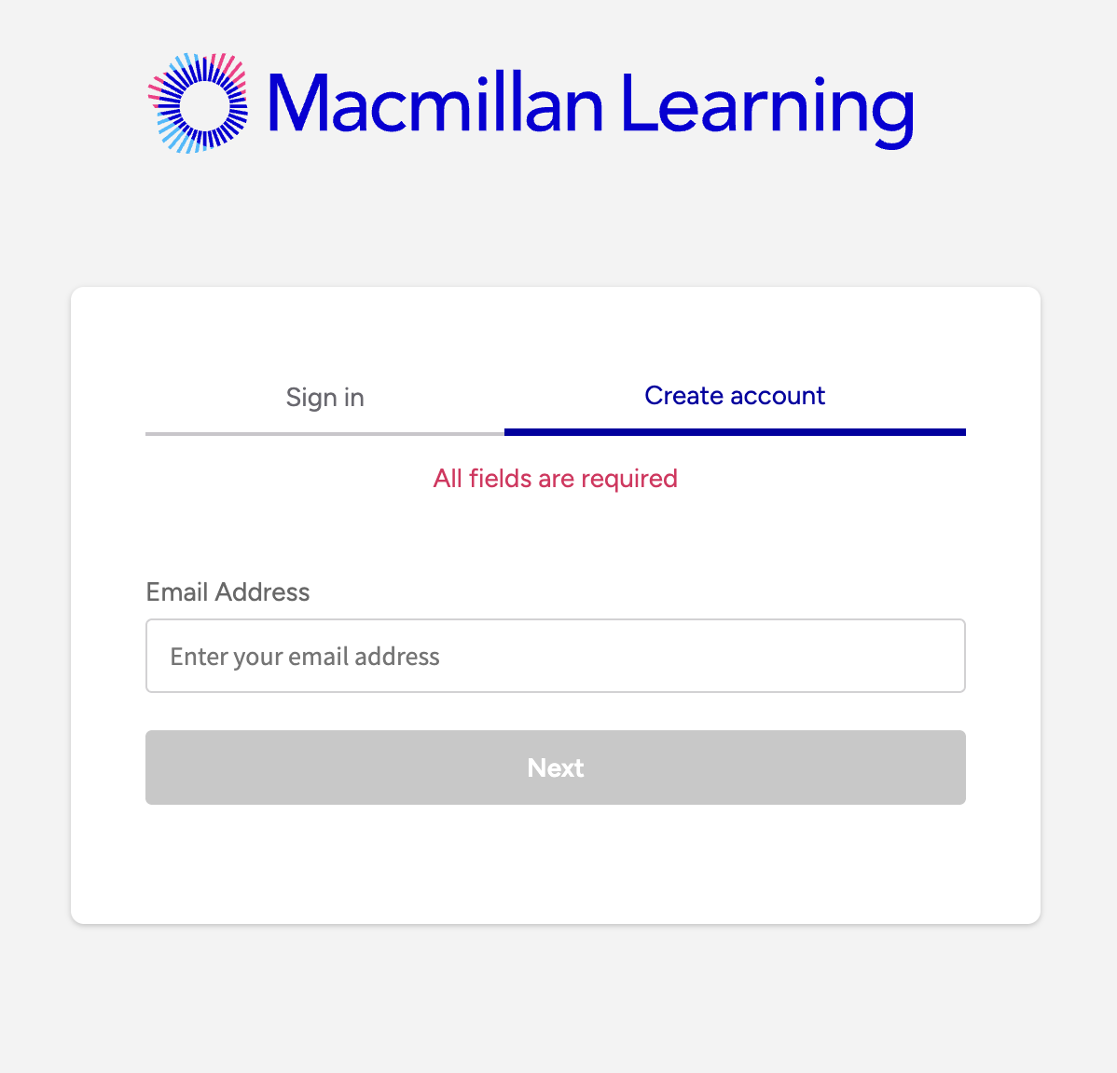
Create Your Account
Every path finishes here. It's the same quick form each time.
1
Fill out the form completely.
2
Note your password and security answers — you'll need them later.
3
Click "Sign Up."
Voilà — you're now enrolled!

Slide 17
STAGE 3
You're In!
Here's how to find your way around Achieve.

Slide 18
Finding Your Way Around
My Course & Assignments
See what's due next and click in to start any assignment.
The E-book
Open it from an assignment or the left menu. Highlight and add notes.
Gradebook
Check the left bar anytime to see your current progress.
Instant feedback
Submit answers, check your work, or get a hint as you go.

Slide 19
Need Help?
We've got you covered — reach out anytime.
?
The Help Icon
Click the question mark — top right before you log in, bottom left after.
✉
Support Pages/Videos
Browse FAQs and step-by-step help articles for common questions. Visit the Achieve Support: Knowledge Base Videos
Your Instructor
Still stuck? Your instructor is a great resource — just ask.

Slide 20
Have a Great Semester!
You're all set. Log in anytime at Achieve.MacmillanLearning.com
Need additional help joining your Achieve course?
Point your phone’s camera to this QR code.

