Slide 1
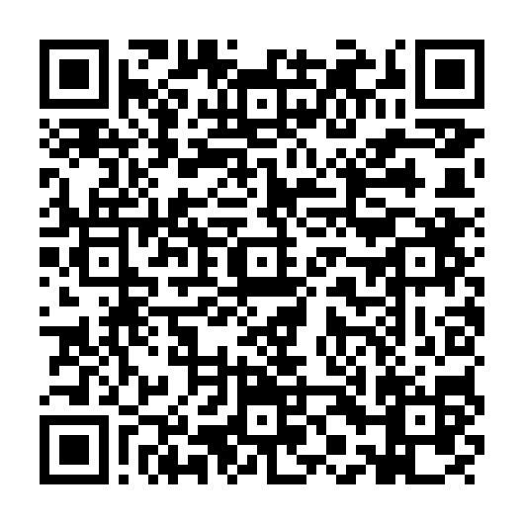
Getting Started with Achieve
Registering through your school's LMS
Scan here for online details:

Slide 2

What is Achieve?
Achieve is your complete online course — everything you need to succeed, in one place.
●
Your e-book Read, search, highlight, and take notes anytime.
●
Homework & quizzes Practice with instant feedback as you go.
[Achieve screenshot]
●
Multimedia tools Videos and activities that help concepts click.
●
A full gradebook Track your progress — and so can your instructor.
●
8% boost on your final exam grade! Students who complete at least 81% of their pre-class activities can expect this boost!

Slide 3
How It Works
Because you're using an LMS, enrolling takes just three steps.
1
2
3
Find your course
→
Connect
→
You're enrolled
Open your LMS and click an Achieve assignment.
Agree to the privacy terms and log in with your school email.
Pay if needed — otherwise you're in automatically.

Slide 4
STAGE 1
Find Your Course

Slide 5
Which LMS?
Tap your school's learning system to jump to its steps.
Blackboard
Ultra
Canvas
D2L
Brightspace
Moodle
Tap to jump →
Tap to jump →
Tap to jump →
Tap to jump →

Slide 6
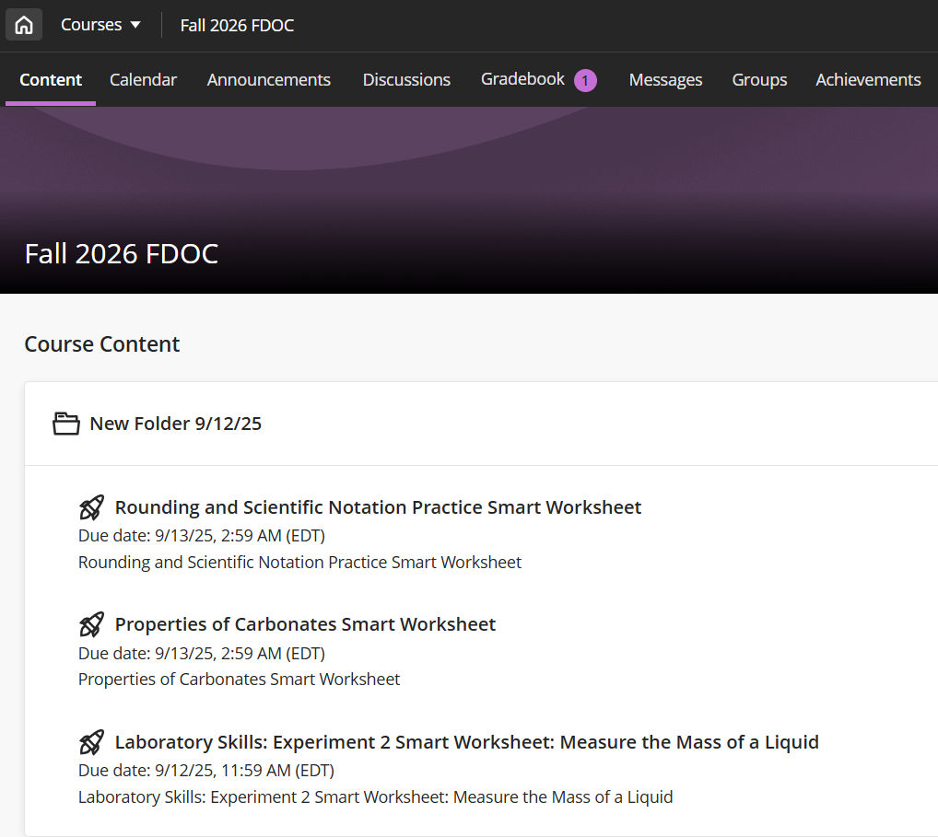
Blackboard Ultra
YOUR LMS · BLACKBOARD ULTRA
1
Log in to your school's Blackboard site.
2
Open your course from the Courses tab.
3
Click an Achieve assignment or link.
Next: Connect to Achieve →

Slide 7
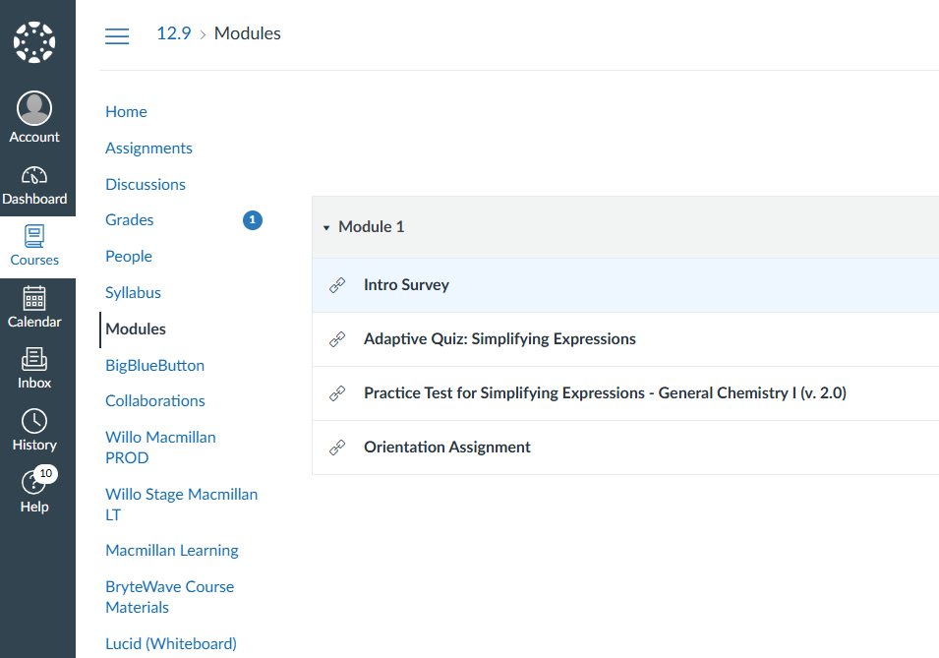
Canvas
YOUR LMS · CANVAS
1
Log in to your school's Canvas site.
2
Open your course from the dashboard tile.
3
In Modules (or Assignments), click an Achieve assignment link.
[Canvas course view]
Not sure which are Achieve? Click "" in the left nav, then the Achieve link.
Next: Connect to Achieve →

Slide 8
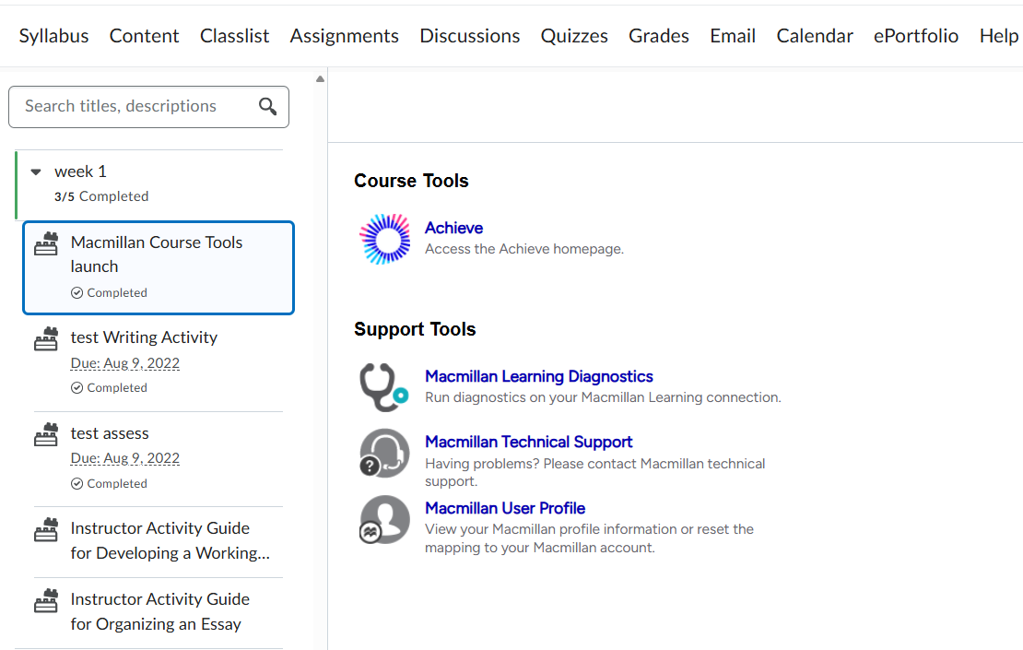
D2L Brightspace
YOUR LMS · D2L
1
Log in to your school's D2L site.
2
Open the D2L course using Achieve content.
3
Find Achieve assignments in the content area.
[D2L course view]
Not sure which are Achieve? Open "Macmillan Course Tools" and click the Achieve link.
Next: Connect to Achieve →

Slide 9
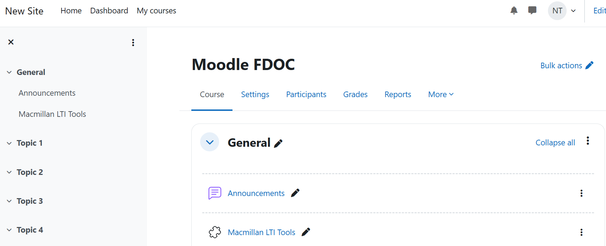
Moodle
YOUR LMS · MOODLE
1
Log in to your school's Moodle site.
2
Open the course with Achieve content (switch via the left sidebar).
3
Click any Achieve assignment to start registration.
Not sure which are Achieve? Open "Macmillan Course Tools" and click the Achieve link.
Next: Connect to Achieve →

Slide 10
STAGE 2
Connect to Achieve
These next steps are the same no matter which LMS you use.

Slide 11
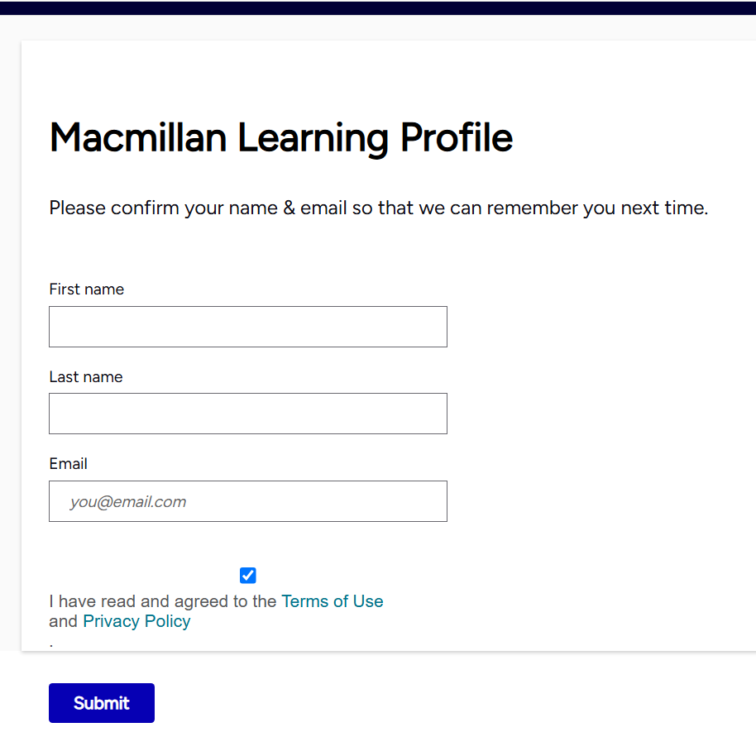
Log In & Connect
After you click an Achieve assignment, you'll connect your account.
1
Review and agree to the user privacy information.
2
Enter the email associated with your LMS account.
3
Continue with the login.
[Privacy & email login screen]
Use your school email. Matching it to your LMS account is what links Achieve to the right course and gradebook.

Slide 12
STAGE 3
You're Enrolled

Slide 13
Finish Enrolling
What happens next depends on your course:
IF PAYMENT IS REQUIRED
IF NO PAYMENT IS NEEDED
You'll see up to three enrollment options. Choose one to enroll and gain access.
Your assignment opens in a new tab and you're enrolled automatically. Nothing else to do.
✓ Your Achieve grades flow straight to your instructor's LMS gradebook.

Slide 14
Need Help?
We've got you covered — reach out anytime.
?
The Help Icon
Look for the question mark inside Achieve to reach our support pages.
✉
Support Pages/Videos
Browse FAQs and step-by-step help articles for your LMS. Visit the Achieve Support: Knowledge Base Videos
Your Instructor
Still stuck? Your instructor is a great resource — just ask.

Slide 15
Have a Great Semester!
You're all set — your Achieve work is now connected to your course.
Need additional help joining your Achieve course?
Point your phone’s camera to this QR code.

